Slide 1

MSBA CAPSTONE PRESENTATION – TEAM 7
Use Case: Predict Customer Success
ALFREDEPHRAIM MURALA | DHARANEESH SUBRAMANI | SAI SADHANKUMAR

Slide 2
AGENDA
Business problem and Objectives
Feature Engineering
Modeling and Limitations
Recommendations and Future works
Dashboard and key metrics
Conclusion and Q&A

Slide 3
BUSINESS PROBLEM
The business problem is that Swire Coca-Cola needs to improve their ability to predict the popularity, longevity, and total 3-year sales volume of new customers in order to make informed decisions about pricing and funding for these businesses.

Slide 4
ANALYTICS OBJECTIVE
PHYSICAL VOLUME
Total cases of materials sold during the whole timeframe
Indicator of potential sales volume prediction
YEARS SINCE ONBOARDING
Number of years between onboarding date and current date
Good target for predicting customer longevity
RATING
Public rating for each Swire customer using Yelp API
Used to predict customer popularity

Slide 5
FEATURE ENGINEERING
Feature engineering improves accuracy of models and helps to better understand variable relationships.
PHYSICAL_VOLUME_LEVEL : Categorized physical volume levels into low (0), medium (1), and high (2) based on percentile values.
YEARS_SINCE_ONBOARDING : Categorized onboarding dates into 3 groups: 1 year or less (1), 1-2 years (2), and over 2 years (3).
RATING : Converted the RATING variable to a binary variable, where a rating of 4 or more is represented as 1 (popular) and anything less as 0.

Slide 6
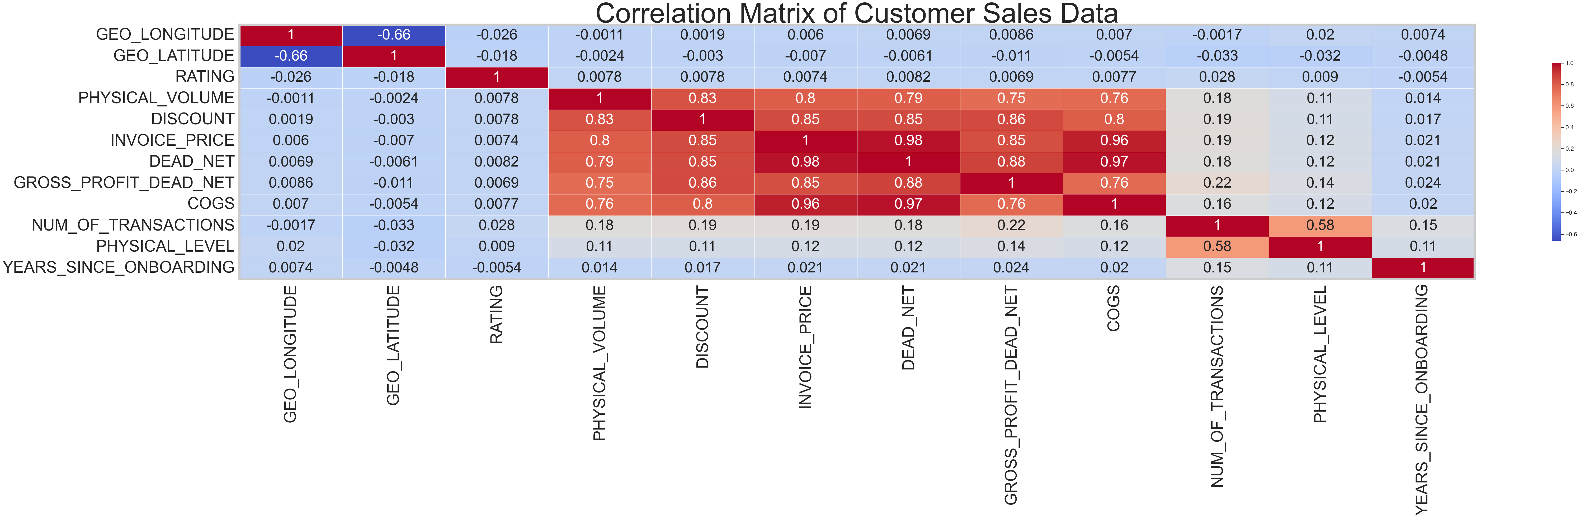
CORRELATION MATRIX

Slide 7
PREDICTOR VARIABLES
'SALES_OFFICE_DESCRIPTION', 'DELIVERY_PLANT_DESCRIPTION', 'ADDRESS_CITY', 'ADDRESS_ZIP_CODE', 'COUNTY', 'GEO_LONGITUDE', 'GEO_LATITUDE’, 'CUSTOMER_ACTIVITY_CLUSTER_DESCRIPTION', 'CUSTOMER_TRADE_CHANNEL_DESCRIPTION', 'CUSTOMER_SUB_TRADE_CHANNEL_DESCRIPTION', 'BUSINESS_TYPE_EXTENSION_DESCRIPTION', 'CUSTOMER_TRADE_CHANNEL_DESCRIPTION2', 'MARKET_DESCRIPTION', 'COLD_DRINK_CHANNEL_DESCRIPTION’ .
Excluded variables that are unique to existing customers.

Slide 8
MODEL EVALUATION
Logistic Regression
Decision Tree Classifier
Random Forest Classifier
Gradient Boosting Classifier
Ensemble Model – Logistic, Random Forest & Gradient Boosting Classifier.

Slide 9
DECIDING THE BEST MODEL
Split data
Train models
Cross-validate
Evaluate performance
Select best model
Tune Hyperparameter
Validate Model

Slide 10
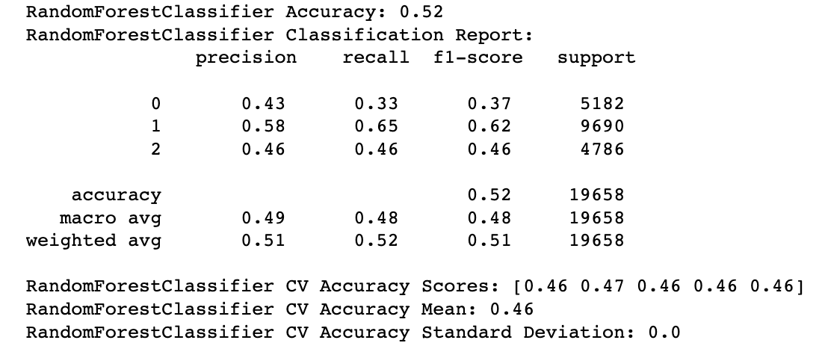
Modeling - PHYSICAL VOLUME LEVEL
Before Oversampling :
Random Forest Classifier Accuracy: 0.52
Only able to predict class 1 (“Medium” in Physical Volume) with reasonable precision and recall

Slide 11
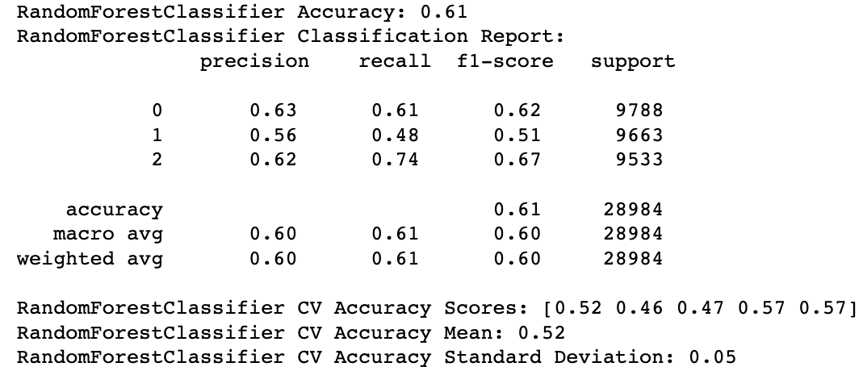
Modeling - PHYSICAL VOLUME LEVEL
After Oversampling :
Random Forest Classifier Accuracy: 0.61
Improved precision, recall, and F1-score for all classes
The performance has improved after oversampling, but it may not generalize well to new, unseen data.

Slide 12
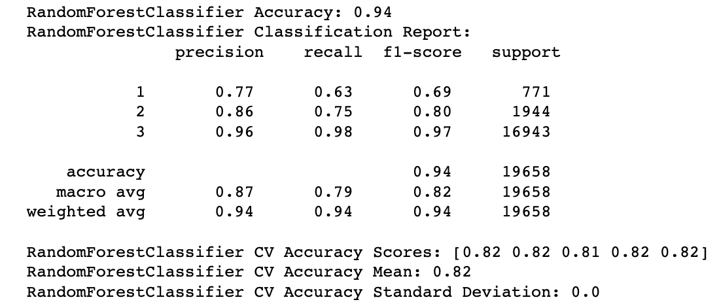
Modeling - YEARS SINCE ONBOARDING
RandomForestClassifier model performs the best with an accuracy of 0.94 and high precision, recall, and f1-score values for all three classes.

Slide 13
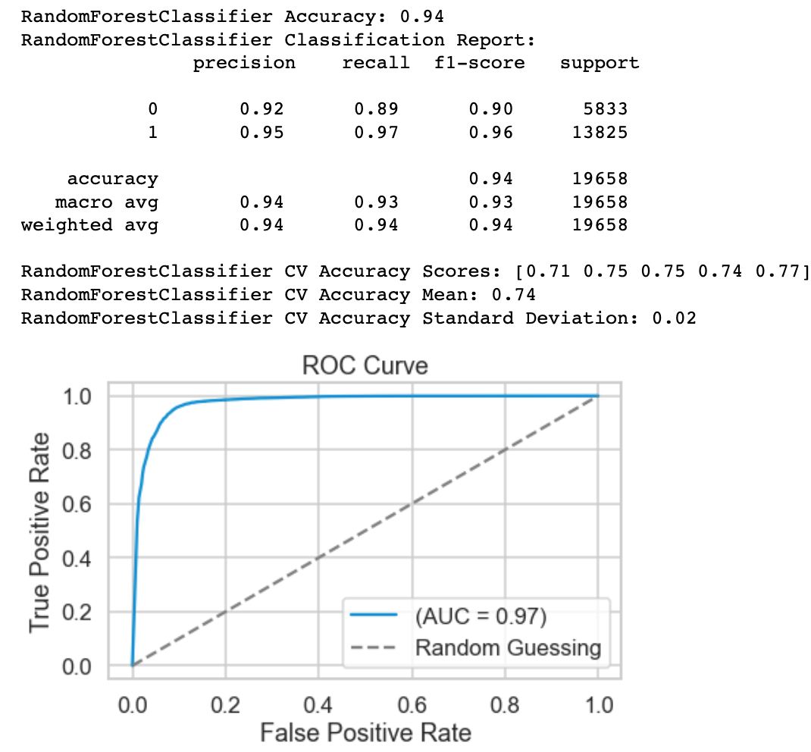
Modeling - RATING
RandomForestClassifier model performs the best with an accuracy of 0.94 and high precision, recall, and f1-score values for both the classes.

Slide 14
LIMITATIONS
Our dataset only covers 2021 and 2022, which may limit the accuracy of long-term predictions such as the total 3-year sales volume
The impact of COVID-19 on customer behavior in 2021 should be taken into account when interpreting physical volume results.
The ratings collected from the Yelp API might be more relevant for food-related businesses and less informative for customers in other categories.

Slide 15
RECOMMENDATIONS & FUTURE WORKS
Use Random Forest Classifier to predict Sales Volume, Longevity and Popularity of new customers
Identify potential successful customers with higher physical volume, longevity over 3 years, and higher ratings
Incorporate population geographic data to enhance accuracy
Regularly monitor and update models with historical data, while considering limitations

Slide 16
DASHBOARD & KEYMETRICS
Our analysis has resulted in a dashboard that provides key insights based on historical data, which can be used to make important decisions on which customer categories to focus on.
By utilizing the dashboard, the business can gain a deeper understanding of the customer base and tailor their strategies to maximize their customer value and drive growth.
Tableau-Public-Swire-Analysis-Dashboard-Link

Slide 17

QUESTIONS

